Slide 1


Data Mining
"Data mining" refers to any set of software tools or automated processes that can access data from one or more databases, and present them in a way that highlights previously unknown relationships and patterns.
Data mining itself is not new. It has been used for years in academic, government, and market research in areas such as risk management and systems analysis.

Slide 2
Who will Mine the Election Data?
The answer is explicit ,
Election commission
Political parties
Media

Slide 3

Where does Data Mining technology enter in?
There have always been voter roles, information stored in databases and you could always break down by census tract or by community or by city.
The technology is now allowing parties to do something which it has never been able to do
  take incompatible data types from all these different databases and actually put data together so that now they have a much more clear view
  who the people are who are the best, most likely targets for the door to door outreach efforts.

Slide 4

Election commission

Slide 5
Election commission (EC)
Mine the data base,
  To minimize the number of polling booths.
  As a result of mining the data The Election commission of India was able to cut down the figures,
state No of booths in 1999 No in 2004
TN 54,847 45,729
  To Improve the security in the polling booths by looking at the past history, where polling was not peaceful (data base may contain info about booths where repolling was ordered).

Slide 6
EC (contd.,)
look for patterns that imply a poor polling percentage (such as terrorist threats etc.,)
To find patterns that cause the number of contestants in a particular constituency to be high (to minimize expenses).
If patterns indicate that the number contestants in a constituency is always maximum, they can try to set a higher deposit amount for that constituency.

Slide 7
Percentage of polling in assembly elections in India over the past years
year | male | female | total
1962 | 63.31 | 46.63 | 55.42
1967 | 66.73 | 55.48 | 61.33
1971 | 60.90 | 49.11 | 55.29
1977 | 65.63 | 54.91 | 60.49
1980 | 62.16 | 51.22 | 56.62
1984 | 68.18 | 58.60 | 63.56
1989 | 66.13 | 57.32 | 61.95
1991 | 61.58 | 51.35 | 56.93
1996 | 62.06 | 53.41 | 57.94
1998 | 63.88 | 57.88 | 60.88
1999 | 63.97 | 55.64 | 59.99

Slide 8
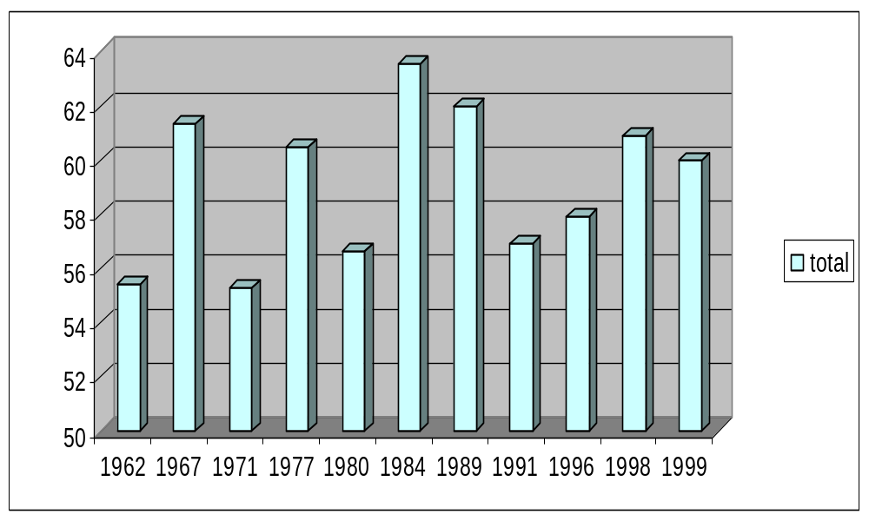
Visualizing the results

Slide 9
The Technology-centric view of the data mining process
DATA
Selection
FOCUSED DATA SUBSET
Preprocessing and
Transformation
PREPROCESSED and FORMATTED DATA
Data Mining
PREDICITIVE MODELS
Human Interpretation
KNOWLEDGE

Slide 10
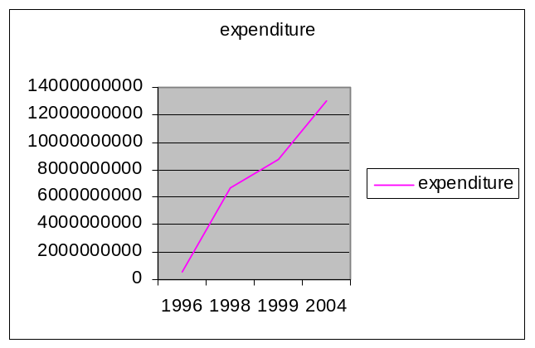

DATABASE
Preprocessing and
Transformation
Data
Data Mining
year | expenditure
1996 | 597344100
1998 | 6662216000
1999 | 8800000000
2004 | 13000000000
MODEL1
Selection
MODEL2
Human Interpretation
KNOWLEDGE

Slide 11
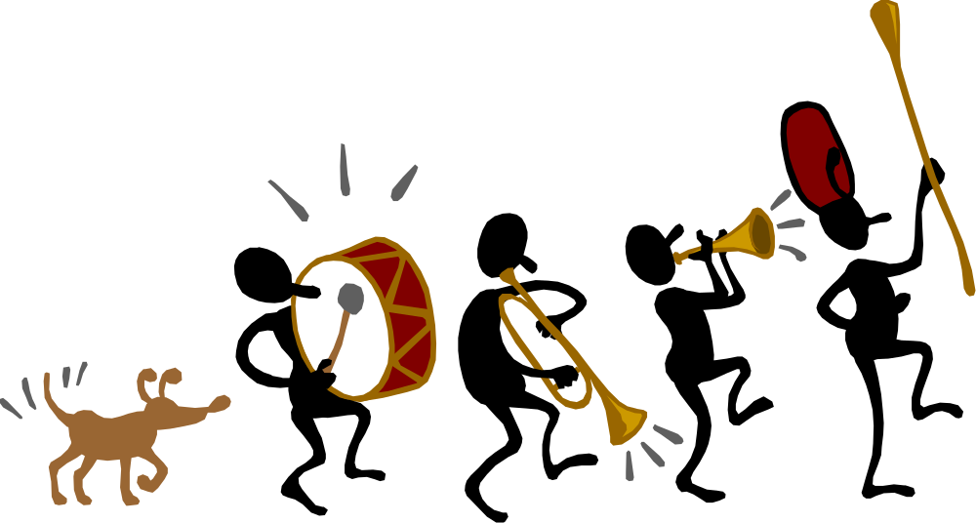
Political Parties

Slide 12
Politics and Data Mining
In the political sphere, data mining technologies are useful in,
  door-to-door canvassing strategy.
  helping to map out an efficient and effective mail.
  To enable campaigns to customize and personalize messages down to specific households with great ease.

Slide 13
How are they doing that?
More particularly, there are 4-5 states that they think will be decisive in the election because the electorate is so polarized right now and there are such a small number of undecided voters out there. Finding who those voters are really matters a lot.

Slide 14
What Political parties do with the data ……..??
In elections to the four state assemblies (MP,Delhi,chattisgar,Rajasthan) conducted a year back, BJP used an elaborate data analysis. (now they are ruling in three states!!!!).
Data analysis is to target messages to specific groups based on castes ,age, income and profession .
Data analysis essential when we look for voting patterns in prior elections.
Political parties may follow the Benchmarking process to improve their results.

Slide 15
The Benchmarking Process
2. Identify
the best
performers
3. Collect and
analyze data
to identify
gaps
4. Set
improvement
goals
1. Define the
domain
7. Repeat
evaluations
6. Evaluate
results
5. Develop and
implement plans to close gaps

Slide 16
Data mining Methodology
The methodology used today in mining consists of just a few very important concepts.
They are,
    Finding a pattern in the data.
    Validating the predictive models.

Slide 17
What is a Pattern?
Consider the simple problem of trying to determine the next number in the following sequence:1212121….?,because the pattern “12” is found often enough ,you have some confidence in the predictive model that says “if 1,then 2 will follow.”
So Pattern is an event or combination of events in a database that occurs more often than expected.

Slide 18
What is a Model?
Model is one that can be successfully applied to a new data in order to make predictions about missing values or to make statements about expected values.
There may not be crisp dividing line between pattern and a model (in the number sequence example, the pattern “12” was also the model), in general pattern are driven by data, whereas a model generally reflects a purpose and may not be driven by data.

Slide 19
Picking the best model
Opinion polls conducted by various media groups
Media group | NDA+ | Cong+ | Others
Sahara | 263-278 | 92-102 | 171-181
Star | 263-275 | 174-186 | 86-98
Aaj Tak | 248 | 189 | 105
Zee | 249 | 117 | 176
NDTV | 230-250 | 190-205 | 100-130

Slide 20
Picking the best model (Contd.,)
But the actual results were,
Media group | NDA+ | Cong+ | Others
Sahara | 263-278 | 92-102 | 171-181
Star | 263-275 | 174-186 | 86-98
Aaj Tak | 248 | 189 | 105
Zee | 249 | 117 | 176
NDTV | 230-250 | 190-205 | 100-130
NDA+ | 185
Cong+ | 220
Others | 137
(The predictive model used by NDTV is some what closer to the actual results)

Slide 21
Media
Mine the data
  To predict what will happen, Which party will win.
  To make opinion polls and exit polls effective.

Slide 22
Data Mining of Elections 2004
Most regional parties lost nearly 95% outside their states.
Those who losing deposits (on account of less than 5% of votes) include,
BJP -27%
Cong -30%
CPM -58%
CPI -85%.

Slide 23

Thank you

